Slide 1

AUTOXR: REAL-TIME AR/VR VEHICLE CUSTOMIZATION
Mohammed Tanvir Rasheed, Ramana Prabhu Sana, Vinay Vuyyuri, Pallavi Yerramilli
Professor: Alex Moehring
MGMT 682 – Digital Product Design

Slide 2
Table of Contents
Product and Customer Need
Problem, End Benefit, and Target Segment
Data and Methods
Choice-Based Conjoint (CBC)
Results and Discussion
Simulations
Conclusion & Recommendations
Limitations

Slide 3

Problem Statement Market Needs & Value Proposition
Vehicle buyers struggle to visualize colors, parts, and accessories accurately before purchase.
This leads to uncertainty, long decision cycles, and costly rework for dealers and custom shops.
AutoXR solves this by projecting full-scale, true-to-life AR customization directly onto the actual vehicle.
Survey (N=40):
72.5% prefer AR over standard previews
65% spend 3+ hours customizing
82.5% choose price ranges < $2,000
AutoXR creates value through realism, faster decisions, and fewer ordering mistakes.

Slide 4
Insights, Methods & Pricing Logic Data, Methods & EVC Market Anchor
Data & Methods:
40 survey responses on customization habits, time spent, AR usefulness, and price perception.
Analysis combined descriptive statistics, willingness-to-pay indicators, and competitor benchmarks.
EVC Market Anchor:
Competitor pricing:
Unreal: $1,850/year
Unity Forma: Enterprise (5–6 figures)
ZeroLight: $100k+/year
Survey anchors:
82.5% expect costs < $2k
Supports AutoXR’s target pricing: $499–$1,499/month for dealers.
Plans (Importance Score) | XR Realism (Importance Score) | Where you can use it (Importance Score) | Saved configurations (Importance Score) | Collaboration features (Importance Score) | Monthly price (Importance Score)
0.118663548 | 0.044594909 | 0.190024727 | 0.077225041 | 0.091433885 | 0.47805789
0.093898516 | 0.192345721 | 0.041596359 | 0.117605628 | 0.203665599 | 0.350888176
0.1069836 | 0.078506837 | 0.183578219 | 0.076824547 | 0.071221046 | 0.482885751
0.085958591 | 0.136475105 | 0.131155103 | 0.100244426 | 0.085945371 | 0.460221404
0.134883879 | 0.161686129 | 0.05226401 | 0.081575833 | 0.207149756 | 0.362440393
0.066179747 | 0.204851681 | 0.021645655 | 0.143855411 | 0.314092579 | 0.249374926
0.109032527 | 0.04835253 | 0.175323631 | 0.069808666 | 0.096389483 | 0.501093162
Notes:
know the market split and how many % are using Unreal and Unity Forma (relevant benchmark) - deep diving based on the current market
for output --> Having a video is fine but not a great value add. But it’s better to add how you explain the survey respondents – to explain conjoint features to show each distinct features and having a video can be useful to summarize the application.
The structure of the report could have been better.
-- add in the survey – how much they wanna pay. its better to show the price based on the experiments and multiple obervations

Slide 5
Differentiators & Conjoint Attributes Why AutoXR Wins & How Attributes Were Chosen
Differentiators
True-scale AR on the real vehicle
High-fidelity, lighting-accurate visuals
Dealer-ready workflow & single price bundle
Reduces rework + uncertainty
Survey Signal:
Users said current tools feel “uncertain” and “not accurate” → supports realism + AR alignment. bundle attributes.
What Users Want
Realistic colors & environment matching
Ability to see mods on their own car
Simple, fast configuration flow
Survey Signal:
Open-ended feedback mentioned color accuracy, lighting, fit confidence, and desire to avoid mistakes.
Attributes
Realism level & lighting accuracy
AR alignment on actual vehicle
Catalog depth
Speed & ease of use
Bundle clarity (single priced package)
Survey Signal:
Users asked for more modification options, fewer steps, and clearer final pricing → justifies catalog, speed, and bundle attributes.

Slide 6

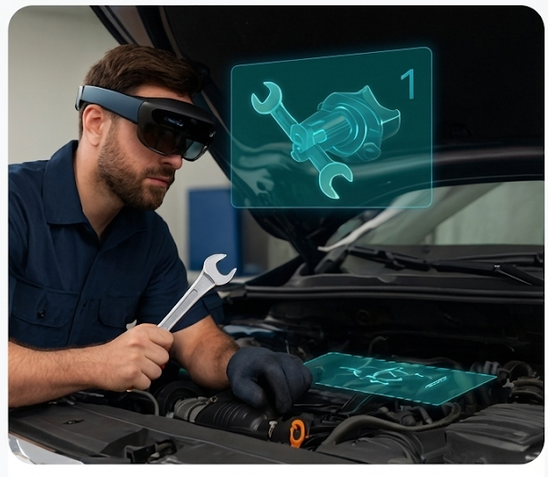
AR Training for Automotive Mechanics Conjoint Insights and Value Proposition
Product: AutoXR is an XR training and demo solution for automotive customers.
Experience: Uses immersive XR to show vehicle features and guide complex tasks.
Goal:
Help users understand advanced features faster.
Reduce confusion during the sales process and after delivery.
Study:
Online choice-based conjoint survey.
Attributes: Plans, XR realism, where you can use it, saved configurations, collaboration features, monthly price.
We use the results to define target segments and a pricing strategy.

Slide 7
What Drives Choice Preferences - Attribute Importance
Our conjoint results show the following importance scores:
Monthly price: 41.2%
Collaboration features: 15.3%
XR Realism (content quality): 12.4%
Where you can use it (showroom vs showroom + home): 11.4%
Plans (feature bundle): 10.2%
Saved configurations: 9.5%
Interpretation:
Price is the single largest driver of choice, which fits a recurring monthly subscription.
Non-price features still matter a lot: collaboration + XR realism + access location together account for almost 40% of decisions.
Customers value useful collaboration tools and high-quality XR realism, not just a cheap plan.

Slide 8
Trouble with Current Solutions (Content + Access) Current Solutions and Unmet Needs
XR Realism:
Level 3 - High detail + reflections and shadows: +37.42 utils
Level 2 - High detail + lighting realism: -36.88 utils
Level 1 - Basic 3D overlay level: -0.54 utils
Interpretation:
Only the highest-realism content delivers clearly positive value.
Mid-level realism and basic overlays sit at or below zero, behaving like “good enough but not exciting” status quo.
Where you can use it:
Showroom + at home: +32.24 utils
Showroom only: -32.24 utils
Interpretation:
Experiences locked to a single showroom location have strong negative utility.
Users clearly prefer XR that follows them home and extends the value of the demo.

Slide 9
Target Users and Segmentation Target Users - Who AutoXR Serves First
Dealer annotations: +20.30 utils
Friends/family sharing: +6.70 utils
No collaboration: -27.00 utils
Interpretation:
Customers strongly dislike having no collaboration.
They value dealer annotations much more than simple social sharing, which fits a professional, sales-oriented workflow rather than casual hobby use.
Primary target segment:
OEM dealerships and larger independent shops that:
Need clear feature explanations and delivery walkthroughs.
Dealer-annotation feature matches their sales and service workflow.
Secondary segment (later): Training academies or enthusiast communities where “share with friends/family” is more important.
Not in Focus now: Social / fun sharing only (friends & family), Users who prefer no XR solution
Collaboration features:
AutoXR
OEM dealerships
Large independent shops
Training academies
enthusiast communities
Primary Segment
Secondary Segment
Not in Focus now
Social/fun sharing
Those who don’t prefer XR

Slide 10
Utilities and Main Drivers Part Worth Utilities – Best vs Worst Profiles
XR realism (content):
Level 3 (high detail + reflections): +37.42 utils,
Level 2 (lighting only): -36.88 utils or
Level 1 (basic overlay): -0.54 utils
→ Only full realism (Level 3) is clearly preferred.
Where you can use it (Access):
Showroom + at home: +32.24 utils or
Showroom only: -32.24 utils → Strong penalty for showroom-only experiences.
Collaboration:
Dealer annotations: +20.3 utils Friends/family sharing: +6.7 utils or None: -27.0 utils → Customers want professional guidance, not no-collab.
Price: $5/month: +135.8 utils, $10/month: -38.2 utils or $20/month: -97.6 utils → Clear price sensitivity across the range.
Overall:
Best profile: Level 3 realism, showroom + home, dealer annotations, lower price.
Worst profile: Mid/low realism, showroom-only, no collaboration, high price.

Slide 11
Willingness to Pay for Key Features Willingness to Pay – Using the Price Attribute
From the price utilities (5 dollars vs 20 dollars per month), the model implies:
One util is worth about $0.06 per month
Extra willingness to pay per month compared to a basic option:
High realism XR (Level 3 instead of Level 1)
Utility difference is about 38 utils. This is worth about $2.4 more per month
Use AutoXR in the showroom and at home (instead of showroom only)
Utility difference is about 64.5 utils. This is worth about $4.1 more per month
Dealer annotations (instead of no collaboration)
Utility difference is about 47.3 utils. This is worth about $3.0 more per month
Interpretation (link to lecture concepts):
These numbers show the monetary value of each feature on the demand curve.
Customers are willing to pay several dollars more per month for:
Better content, more usage occasions, better guidance.
This supports a two-tier strategy: a basic plan and a premium plan that captures this extra value.

Slide 12
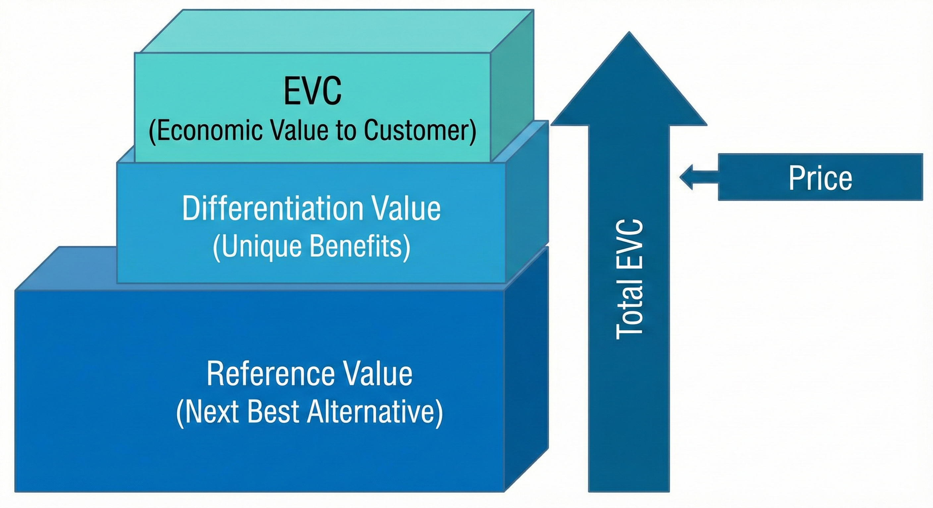
EVC Analysis Competitive Landscape & Reference Value
Reference Anchor:
Unreal Automotive Configurator ($1,850/yr).
High fidelity, but lacks dealer workflows and full-scale AR integration.
Market Ceiling: Enterprise solutions like Unity Forma/ZeroLight cost more ($100k+).
AutoXR Opportunity:
Fills the "Mid-Market" gap
More capable than raw tools (Unreal), more accessible than enterprise engines.
Survey Validation:
72.5% found reference prices "about right" or "too low,"
Users value realism over budget tools.
Conclusion: AutoXR’s base utility exceeds the $1,850/yr benchmark.

Slide 13

EVC Analysis Value Drivers & Positioning
AR Superiority: 72.5% rate AR better than standard previews; AutoXR adds unique full-scale alignment on physical cars
Operational Efficiency: 65% of users spend 3+ hours customizing. AutoXR drastically accelerates this, saving dealer labor costs..
Visual Trust: Open-ended comments emphasize the critical need for accurate visuals. AutoXR mitigates the customer remorse.
Final Pricing: The price premium over Unreal (~$154/mo vs. AutoXR’s ~$500+) is justified because AutoXR is sold as a sales platform

Slide 14
Choice-Based Conjoint (CBC) Analysis
Why CBC?
Find Trade-offs between features and cost
Calculate MVP
Calculate Price Elasticity and WTP
Key Attributes:
XR Realism: Basic Overlay vs. High-Fidelity Reflections
Usage Location: Showroom Only vs. + At Home
Save Configuration: 3 Setups vs. 10 Setups
Monthly Price: $5, $10, $20
Sampling & Estimation
Mixed Population of Digital and Traditional Users, mainly students.
Utility Scores to WTP

Slide 15
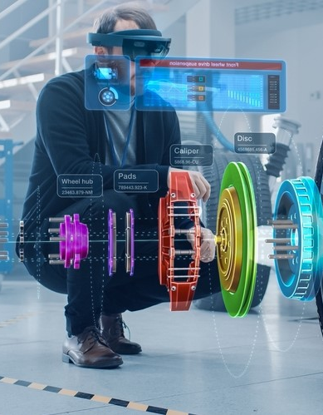
Simulations Overview
Goal: Converting conjoint utilities into expected adoption at different prices
Approach:
Use CBC results to simulate choices between:
Premium bundle (Plan B, Level 3 realism, showroom + home, 10 saves, dealer annotations)
Basic bundle (Plan A, Level 1 realism, showroom only, 3 saves, no collaboration, $10/month)
None option (“I would not choose any plan”)
Include None in all simulations to reflect real opt-out behavior
Calibration:
Respondents chose None in 18.3% of CBC tasks
We calibrate the simulations so model “None” share matches 18.3% at the $10 reference point

Slide 16
Take-up vs Price
Simulation setup:
Premium price varies; Basic is fixed at $10/month
Premium bundle includes Plan B, Level 3 realism, showroom + home, 10 saves, dealer annotations
Key patterns from the simulation:
Premium adoption is strong in the $14–$15/month range
Take-up remains around 50–58% in this zone
As price increases toward $20/month,
None share grows sharply
Many users drop out rather than accept a high premium price
Basic plan stays weak because it combines low realism, showroom-only access, and no collaboration, all of which have negative utilities
Implication:
The $14–$15/month range is a good starting point for a Premium tier: still attractive, without competing purely on being the cheapest option.

Slide 17
Segment Comparison
Key segment split (Q1):
Customized before: online, showroom, or both
Never customized: first-time customizers
Observed behavior in CBC (None choices):
Overall, None rate: 18.3%
Customized before: ~10.4% None
Never customized: ~42.2% None
Simulation at $15/month Premium:
The Premium bundle at $15/month is strongly attractive for experienced customizers
First-time customizers are much more likely to choose None, even at the same price
This segment likely needs:
A lighter, simpler trial or entry plan, or
A dealer-guided onboarding flow that explains the tool and options
Segment | Premium share | None share
Customized before | 66.2% | 33.8%
Never customized | 23.6% | 76.4%

Slide 18
Overall Conclusion
1. Product fit:
AutoXR’s value lies in high realism, showroom + home access, and guided collaboration (dealer annotations)
2. Customer segment:
Best near-term fit: OEM dealerships and larger independent shops serving buyers who already customize online or in showrooms
3. Pricing strategy:
Use a tiered structure rather than a single flat price
Position Premium in the $14–$15/month range (per end-user equivalent), anchored by EVC and simulations
For dealers, a $150/location/month subscription is perceived as close to “about right” on average
4. Adoption risk:
Comfort (motion sickness) and privacy are key concerns that must be actively managed

Slide 19
Recommended Configuration & Price
Recommended Premium configuration (v1):
Plan: Plan B
XR realism: Level 3 (high detail + reflections)
Where to use: Showroom and home
Saved configurations: Up to 10 setups
Collaboration: Dealer annotations
Why this configuration:
Aligns with highest utilities on realism, access, and collaboration
Matches survey attitudes: realism and confidence (Q5, Q6, Q8) and desire to use AutoXR (Q11)
Recommended pricing:
Basic: $10/month (low realism, showroom-only, minimal collaboration)
Premium: $14–$15/month
≈ 70–75% of calculated EVC (~$19.6/month)
Supported by simulation take-up and willingness-to-pay
Dealer package: AutoXR Pro at $150/location/month with ROI justification (upsell, faster explanations, fewer post-sale questions)

Slide 20
Limitations
Sample and context:
n = 40, mostly students and early-career professionals
Not fully representative of all dealership customers or markets
Stated preference vs real behavior:
CBC choices may not perfectly match real-world decisions, especially at higher prices
Comfort and motion sickness:
Most frequent open-ended concern; real-world adoption may be lower if XR comfort is not addressed
Pricing model skepticism:
Some respondents questioned why individuals would pay a subscription
Supports a B2B focus on dealers and OEMs with clear ROI framing
Privacy:
Several respondents mentioned privacy; data capture on or around vehicles must be designed carefully
Simulation scope:
Simulations assume static bundles and do not fully capture hardware availability, dealer training, or in-dealership experience

Slide 21

References
[1] Orme, B. K. (2014). Getting started with conjoint analysis: Strategies for product design and pricing (3rd ed.). Madison, WI: Research Publishers LLC.
[2] Sawtooth Software. CBC/HB: Software for hierarchical Bayes estimation of individual-level utilities. Retrieved December 9, 2025, from Sawtooth Software website.
[3] Louviere, J. J., Hensher, D. A., & Swait, J. D. (2000). Stated choice methods: Analysis and application. Cambridge, UK: Cambridge University Press.
[4] Epic Games. Unreal Engine for automotive configurators. Retrieved December 9, 2025, from the Unreal Engine automotive solutions page.
[5] Unity Technologies. Unity Forma: Real-time 3D marketing for automotive products [Software]. Retrieved December 9, 2025, from the Unity Forma product page.
[6] ZeroLight Ltd. ZeroLight: Real-time 3D visualization and car configurator platform. Retrieved December 9, 2025, from the ZeroLight solutions overview page.

Slide 22

Thank you
Any Questions?

